Slide 1

Cultivate
How to use data to design and refine your elearning.
5C Framework for successful digital learning

Slide 2
Cultivate:
The fourth C of the 5C framework
Imagine knowing that the optimum length for your digital learning topics is 8 minutes, that videos with social polls and reflective questions get 40% more uptake over videos without and the reason learners are dropping out of a topic after just one minute is purely because of a simple error on page 3, which you can easily fix.
Cultivating your digital learning is more than doing, waiting and evaluating. To be the best, stay ahead, meet customer expectations and needs and hit those important performance targets, you need to read your audience, uncover problems, spot opportunities and be reactive to needs. The good news is that with data dashboards, you can - and easily.
This Cultivate tool shows your how to draw insights from your data feeds to focus your projects from the beginning - and at every steps of the way - to ensure they hit the mark and deliver the stats you need them to.amework.
Need some support? Find out more about our Learning Consultancy team and our coaching and design services at each stage of the 5Cs Framework.

Slide 3
1
Cultivate: Ahead
Draw on data and insights to shape the direction of your digital learning project, before you get stuck in the design.
3. What are your direct competitors offering? Is it working? How can you improve upon that?
1. What did you learn from your last project?
What worked well? What didn’t? What devices were used to access it? How did learners use it? How much? What did they say about it?
2. What does your audience tell you they need?
Use surveys, polls, open input questions, conversations and observations to gather up as much information as you can.

Slide 4
2
Cultivate: During
During the Conceptualize and Create phases of your project, we recommend continually testing and checking out your data feed to assess if your design is working. You can do this with a sample of end users early on, and then your full audience as you release it. It’s never too late to make changes, especially when it can make or break your project’s success.
A/B test
If you’re embracing a new design strategy, get it right by running some A/B testing and seeing what works best. Try standalone expert videos vs. the same videos with a simple poll question. Which gets higher user engagement and ratings? Test out offering a range of standalone topics vs. the same topic with a built-in menu.
Which do users respond best to? Does your content do better on or off an LMS?
Ideas for what we should A/B test on our project to find out the best format/use or media/brand:

Slide 5
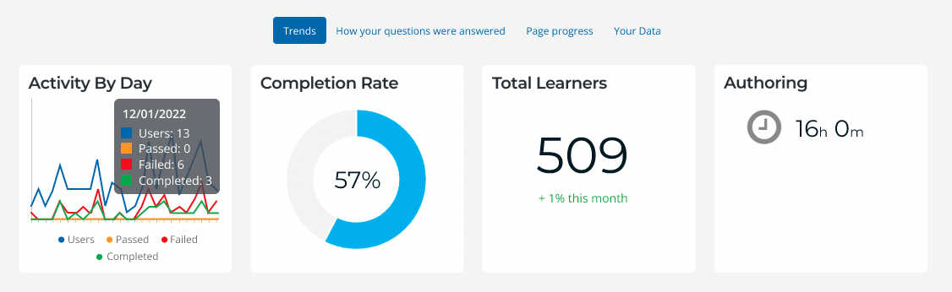
Monitor your dashboards
Data dashboards will become your best friends during your prototyping and production phase. Good ones update automatically with live user data.
Below we’ve taken the dashboards available in Elucidat Analytics to highlight the top ten stats to monitor. Look also to your LMS, surveys, user feedback and performance measures to get a fuller picture.
1
Monitor sessions vs. total users. Are users coming back for more?
2
Does completion matter to your project? If it’s a linear experience is everyone getting through to the end? If not, why? If it’s a range of performance topics that learners can explore freely, look instead at which pages/topics are visited, and by whom.
3
Are you reaching your target number of users, and in the locations you are aiming for? Do you need to market your product more in certain areas, or help it spread virally?
1
2
3

Slide 6
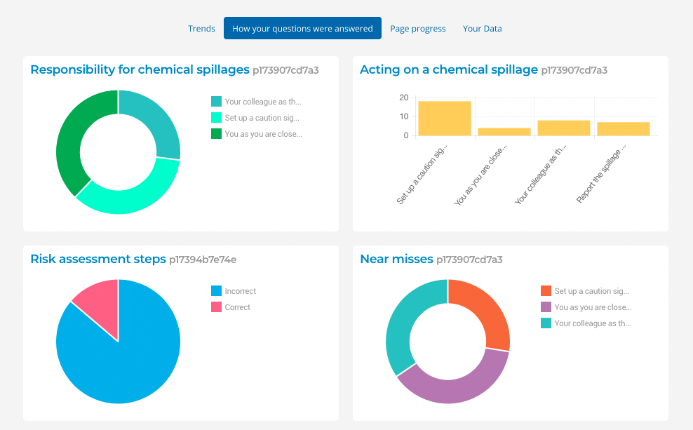
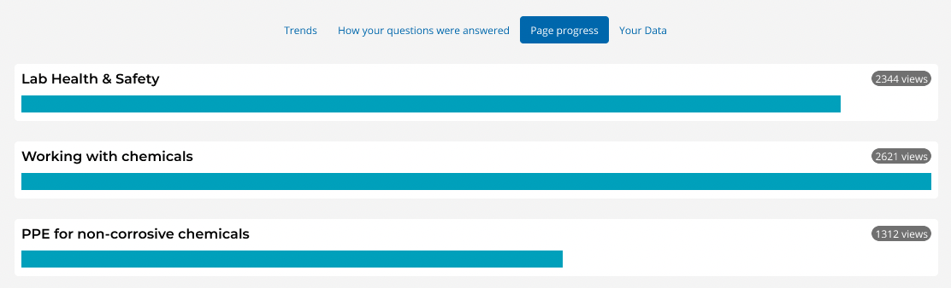
7
8
4
5
6
Which questions are 90 - 100% of users getting right first time? Was it designed to be that easy, or do you need to make it harder?
6
7
What pages are you seeing the total number of users drop from? Dig deeper to find out why this might be: page errors/lower engagement/less relevant content/ UX issues, or perhaps they have all that they need and the rest can be cut!
4
What results are you seeing from polls, and what do they tell you about user attitudes/perceptions/belief? Do these need to be challenged ahead of “learning”?
8
5
If you’ve created branches in your content, where are the majority of users going? What does this tell you about their needs/behaviours/profiles?
Which really important question are users struggling with? What does this tell you about where they may really be struggling on the job? How can you further help them?

Slide 7
Get feedback from users
Build in a user-rating survey into each of your digital products or topics to capture their honest views. It’ll take them two seconds if it’s a simple Likert question, but give them the option to provide written feedback too. If you’re using Elucidat, it will all appear in your Analytics dashboard. When coupled with the other data you have, you can get insight into why one topic gets 5 stars when another only gets 3. Also, look at text inputter by users to reflective questions or action-planning tasks. Should you pass this on to coaches/facilitators/managers to continue their learning around it?
User feedback that needs action
Take action
Quick wins - what changes can you make now to improve on key stats
Longer term - considerations for the future.

Slide 8
3
Cultivate: Further on
Sometimes key performance indicators take a while to come to fruition, such as increases in sales, reductions in incidents and compliance risks. But the key to health cultivation is to balance data about users and usage along with performance on the group. What we all hope for is a positive outcome on performance.
Measure your KPIs
If you’ve follow the Capture stage of our 5C Framework, it’s likely you’ll have a set of clear performance targets for your digital learning project. How are you doing?
Below target?
On target
Above target
Use data alongside polls, surveys, 360 feedback, manager performance feedback, observations of performance, customer feedback and more.
Go deeper
Is this the case for all target roles/teams? And how does this correlate to your learning project in terms of take up/completion/pass rates/user ratings?
Evaluate
What conclusions can you draw about what’s working, what’s not working and what else you could develop or do to boost your project’s success?

Slide 9
Cultivate
What next?
Get more 5C Framework guides These will help you to generate design concepts, speed up your production process and much more! Discover our coaching and design services Get hands on support and guidance to help you deliver real-life impact from your projects. Talk to us We’d be happy to help with any questions you have about this guide and discuss how we can help you further.
We hope you’ve found this guide useful!
Cracking the data to inform your projects is a game-changer and is essential to really delivering real-life impact with your elearning.
If you’d like one-to-one support with getting actionable insights from your data, our Learning Consultancy team can help, please get in touch.

